Slide 1

Hospital Records Analysis for Public Health Programme

Slide 2
Problem Statement: Hospital Records Analysis for Public Health Programme
As part of a public health initiative, you have been tasked with analyzing hospital records to track the progress of common illnesses. The data is stored across three tables: patients, symptom, and visit. The patients table contains information about each patient, including their age and city of residence. The symptom table records the symptoms reported by patients during their visits, while the visit table documents each patient's visit to the hospital, including the diagnosis made during each visit.
Objective is to extract meaningful insights from this data to inform the development of a public health program. To accomplish this, you need to write SQL queries to address various analytical questions

Slide 3
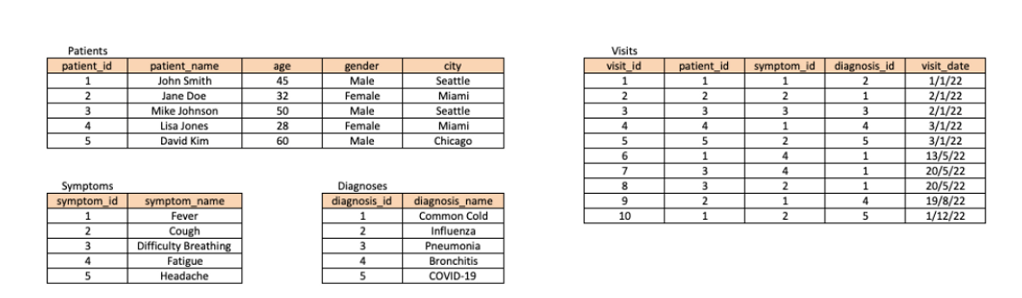
TABLES

Slide 4
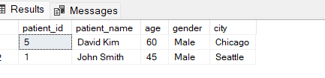
1. Write a SQL query to retrieve all patients who have been diagnosed with COVID-19
select p.patient_id, p.patient_name,p.age,p.gender,p.city
from Patients as p
join Visits as v
on p.patient_id=v.patient_id
join Diagnoses as d
on v.diagnosis_id=d.diagnosis_id
where d.diagnosis_name='COVID-19';

Slide 5
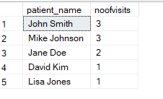
2. Write a SQL query to retrieve the number of visits made by each patient, ordered by the number of visits in descending order.
select p.patient_name ,count(p.patient_name) as noofvisits
from Patients as p
join Visits as v on p.patient_id=v.patient_id
group by p.patient_name
order by count(p.patient_name) desc;

Slide 6
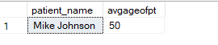
3. Write a SQL query to calculate the average age of patients who have been diagnosed with Pneumonia
select p.patient_name ,avg(p.age )as avgageofpt
from Patients as p
join Visits as v on p.patient_id=v.patient_id
join Diagnoses as d on v.diagnosis_id=d.diagnosis_id
where d.diagnosis_name='Pneumonia'
group by p.patient_name

Slide 7
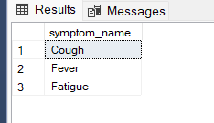
4. Write a SQL query to retrieve the top 3 most common symptoms among all visits.
select symptom_name from (select top 3 s.symptom_name,count(*)as cs
from Symptoms as s
join Visits as v on s.symptom_id=v.symptom_id
group by s.symptom_name
order by count(*) desc)as sp;

Slide 8
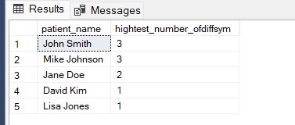
5. Write a SQL query to retrieve the patient who has the highest number of different symptoms reported
with cte as (select p.patient_name,s.symptom_name ,DENSE_RANK() over(partition by p.patient_name order by s.symptom_id ) as rn
from Patients as p
join Visits as v on p.patient_id=v.patient_id
join Symptoms as s on v.symptom_id=s.symptom_id
)
select cte.patient_name,count(rn) as hightest_number_ofdiffsym from cte
group by cte.patient_name
order by count(cte.rn) desc;

Slide 9
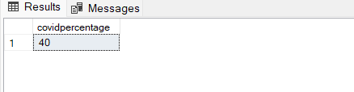
6. Write a SQL query to calculate the percentage of patients who have been diagnosed with COVID-19 out of the total number of patients.
or
select count(*)*100/5 as covidpercentage from(select p.patient_name from Patients as p
join Visits as v on p.patient_id=v.patient_id
join Diagnoses as d on v.diagnosis_id=d.diagnosis_id
where d.diagnosis_name='COVID-19')as sp
with covidpt as (
select distinct p.patient_id ,p.patient_name
from Patients as p
join Visits as v on p.patient_id=v.patient_id
join Diagnoses as d on v.diagnosis_id=d.diagnosis_id
where d.diagnosis_name='COVID-19'),
totalpt as (select p.patient_id,p.patient_name from Patients as p)
select count(covidpt.patient_id)*100/count(totalpt. patient_id)as covidpercentage
from covidpt
full join totalpt on covidpt.patient_id=totalpt.patient_id

Slide 10
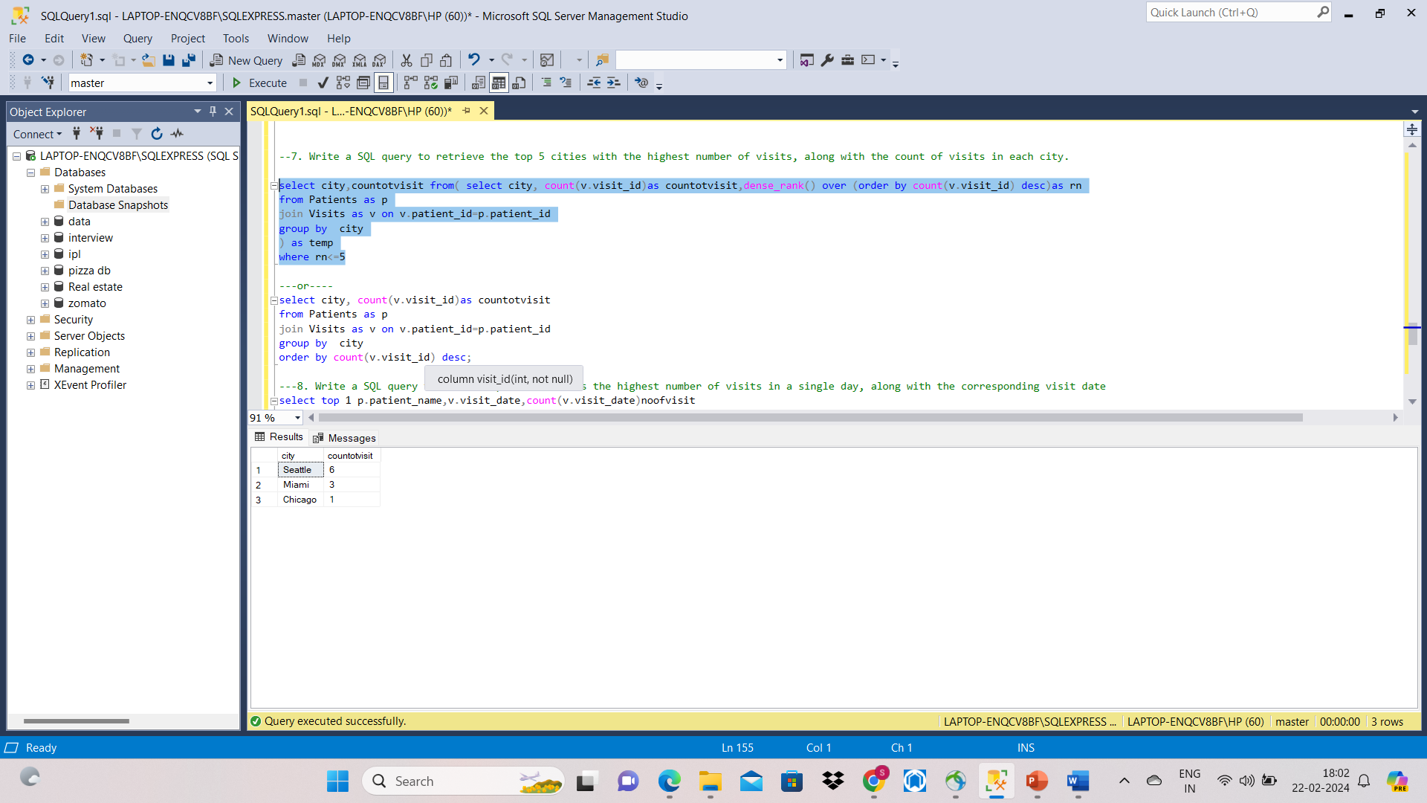
7. Write a SQL query to retrieve the top 5 cities with the highest number of visits, along with the count of visits in each city.
select city,countotvisit from( select city, count(v.visit_id)as countotvisit,dense_rank() over (order by count(v.visit_id) desc)as rn
from Patients as p
join Visits as v on v.patient_id=p.patient_id
group by city
) as temp
where rn<=5
---or----
select city, count(v.visit_id)as countotvisit
from Patients as p
join Visits as v on v.patient_id=p.patient_id
group by city
order by count(v.visit_id) desc;

Slide 11
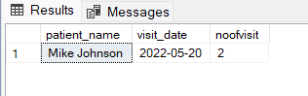
8. Write a SQL query to find the patient who has the highest number of visits in a single day, along with the corresponding visit date.
select top 1 p.patient_name,v.visit_date,count(v.visit_date)noofvisit
from Patients as p
join Visits as v on p.patient_id=v.patient_id
group by p.patient_name,v.visit_date
order by count(v.visit_date) desc
---or-----------------------------------------
select patient_name,visit_date from(select p.patient_name,v.visit_date,count(v.visit_id)noofvisit,rank() over (order by count(v.visit_id) desc) rn from Patients as p
join Visits as v on p.patient_id=v.patient_id
group by p.patient_name,v.visit_date) as temp
where rn=1

Slide 12
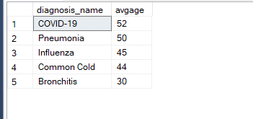
9. Write a SQL query to retrieve the average age of patients for each diagnosis, ordered by the average age in descending order.
select d.diagnosis_name,avg(p.age)avgage from Diagnoses as d
join Visits as v on d.diagnosis_id=v.diagnosis_id
join Patients as p on v.patient_id=p.patient_id
group by d.diagnosis_name
order by avg(p.age) desc

Slide 13
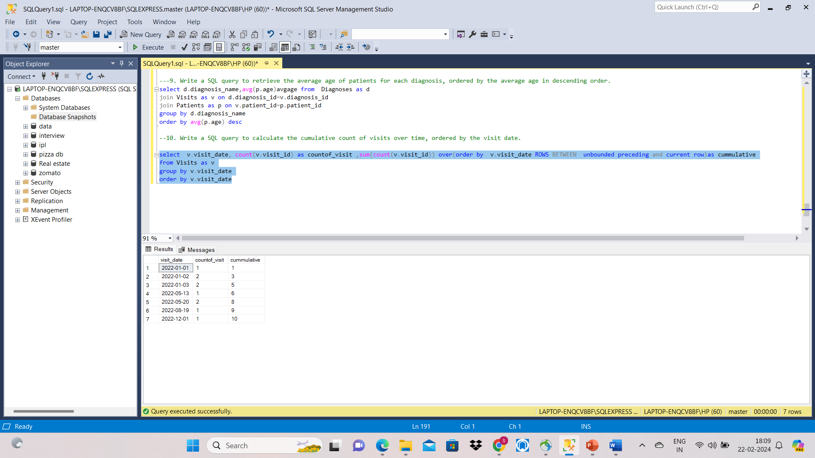
10. Write a SQL query to calculate the cumulative count of visits over time, ordered by the visit date.
select v.visit_date, count(v.visit_id) as countof_visit ,sum(count(v.visit_id)) over(order by v.visit_date ROWS BETWEEN unbounded preceding and current row)as cummulative
from Visits as v
group by v.visit_date
order by v.visit_date

Slide 14
Conclusion
Healthcare Data Analysis Project
As part of a public health initiative, led a comprehensive data analysis project aimed at understanding the prevalence and progression of common illnesses within a healthcare system. Leveraged SQL queries to analyze hospital records stored in three key tables: patients, symptom, and visit.
Identifying COVID-19 Cases: Developed SQL queries to retrieve all patients diagnosed with COVID-19, providing critical insights into the spread of the virus within the community.
Patient Visit Analysis: Designed SQL queries to determine the number of visits made by each patient, enabling the identification of high-utilization patients and potential areas for targeted intervention.
Symptom Trends: Utilized SQL queries to identify the top three most common symptoms reported across all visits, informing healthcare providers of prevalent symptoms and guiding symptom-based diagnosis strategies.
Demographic Insights: Calculated the average age of patients diagnosed with Pneumonia, offering valuable demographic insights for disease management and resource allocation.
Public Health Metrics: Analyzed the percentage of patients diagnosed with COVID-19 out of the total patient population, contributing to the assessment of disease burden and informing public health policy decisions.
Geospatial Analysis: Identified the top five cities with the highest number of visits, facilitating geospatial analysis to pinpoint areas of high healthcare demand and prioritize resource allocation.
Patient Engagement Strategies: Investigated the patient with the highest number of different reported symptoms, informing personalized patient engagement strategies and tailored healthcare interventions.
Longitudinal Analysis: Calculated the cumulative count of visits over time, providing longitudinal insights into healthcare utilization patterns and enabling trend analysis for proactive healthcare planning.

